Slide 1
PACT within Speech & Language Therapy
Working with families and empowering settings with the support of Specialist Teachers
Kate Lemon and Katy Willis : Specialist Speech and Language Therapists
Oxford Health NHS Foundation Trust

Slide 2
Agenda
Beginning to deliver PACT in Oxfordshire
Growing our team
Training
Supervision
Our pathway
Sharing the PACT ethos with “May I Join You?”
Our vision

Slide 3
Setting the scene
During Covid there were large numbers of children on the caseload with social communication needs who needed support.
We have seen and continue to see a significant increase in referrals for children with social communication needs.
Wanting to offer evidence-based intervention that would have a lasting impact.
Wanting to move away from the model of the therapy being delivered directly to the child but through empowering the most important people in the child’s world.
Wanting to enable parents to be able to tune-in even more to their children; validating their interests, their ideas, their communication and through this increased understanding creating opportunities for connection.

Slide 4
Starting with one
Our clinical lead, Sarah Rae discovered PACT through a review of the research and was keen to bring this approach to Oxford Health.
In 2021, gaining funding to send one Band 6 Specialist Speech and Language Therapist (Katy) on the PACT training.
Katy beginning with 5 families in July 2021. Initial PILOT 1 day/week. As there were still Covid restrictions also beneficial as PACT could be delivered remotely.

Slide 5
Positive Feedback
I got half way through my first video before calling it a day. My toes were curling! Constant bombardment of asking him to repeat words, no mirroring whatsoever and introducing new toys at every opportunity - ew!
Without blowing my own trumpet I've definitely improved a lot since then 😄
Thanks for everything you've done for us. It's definitely opened my eyes to how I interact with him and I'm sure he's happier as a result 🙂

Slide 6
More people trained
Kate (as a second Band 6 SLT) joined in April 2022 (2.5 days/week) hybrid role to deliver more PACT digitally and also to train more staff.
NHS ENGLAND funded trainings :
1. October 2022 : 4 Speech and Language Therapists(SLTs) and 3 Speech and Language Technical Instructors(SLTIs)
2. October 2023 : 5 SLTs and 1 SLTI.
3. May 2024 : 8 SLTs and 1 SLTI.
Ensuring the balance always of having enough trained and skilled SLTs to support others developing their PACT skills.
Notes:
All Speech and Language Therapy staff trained using NHS England funding.
All Speech and Language Technical Instructors trained using our own Speech and Language Therapy budget.
Cost saving through Kate as an IMPACT associate being able to deliver training and supervision within her NHS role.
Discovered along the way the importance of having the right balance of Speech and Language Therapists and Speech and Language Technical Instructors.

Slide 7
Current numbers trained
17 Speech and Language Therapists
5 Speech and Language Technical Instructors
With careful planning to make sure that we have Speech and Language Therapists and where possible also a Speech and Language Technical Instructor in each of our area team. 6 area teams in total.
Over the 2 years only lost 3 members of staff due to role changes and 1 has recently returned to work for us again.

Slide 8
Skill mix
Recognising the extraordinary skills of our SLTIs :-
Extensive experience of working with children with Autism.
Previous relevant career experience.
The ability to build good relationships.
Feeling confident that the format of the PACT training would enable staff to transition from more direct work with children to empowering others through video feedback.
SLTIs have more clinical time supporting children both at home or in settings.

Slide 9
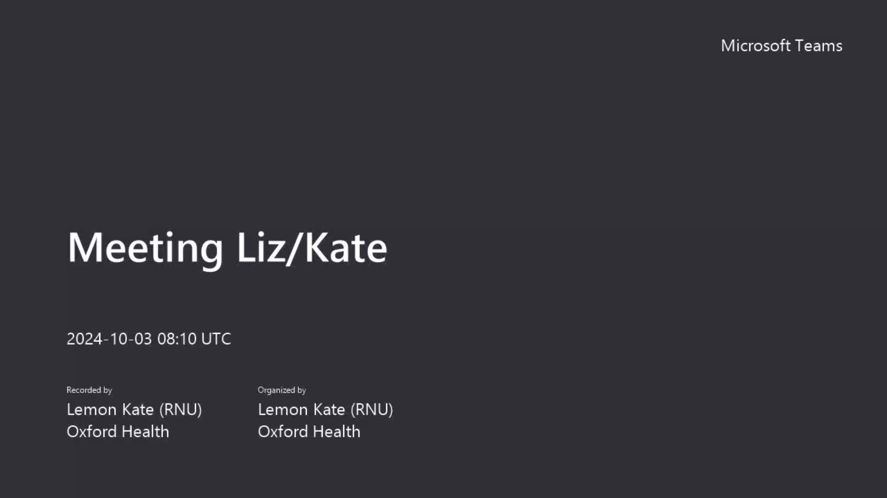
Liz Murphy : Speech and Language Technical Instructor
Notes:
Video of Liz Murphy one of our Speech and Language Technical Instructors talking about PACT within her role.

Slide 10
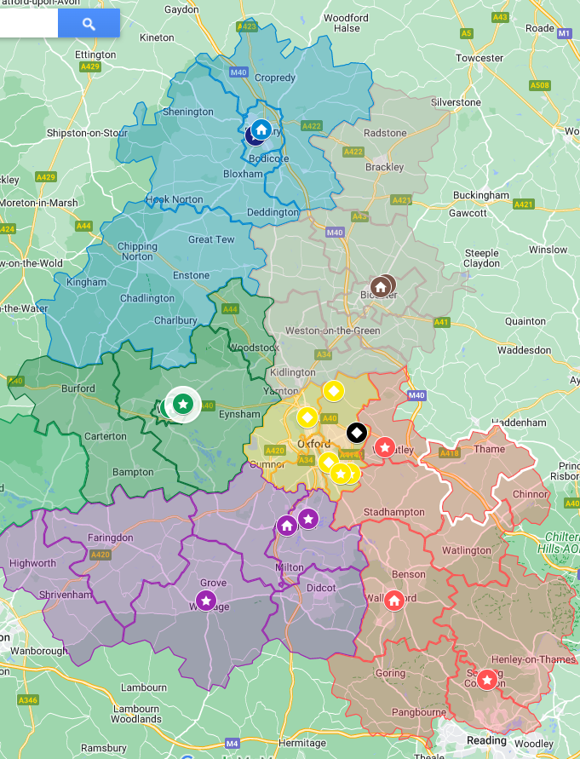
Our 6 area teams within Oxfordshire

Slide 11
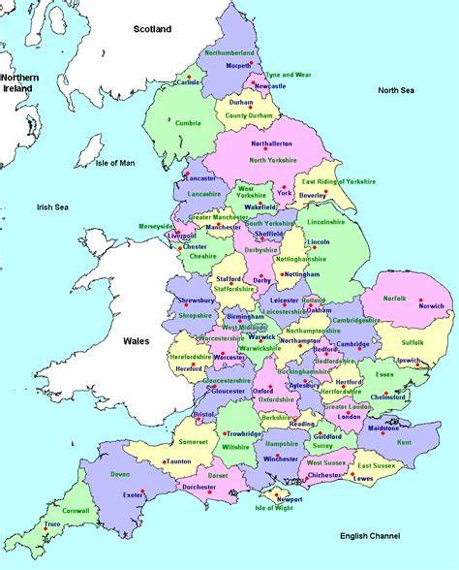

Oxfordshire
A county in England, United Kingdom.
Notes:
A large county with a large population. (Be more specific here??)

Slide 12
Benefits of the remote offer
Limited parking available at our clinics.
Travel time for families.
Reach families that don’t have access to a car or afford travel.
Parents anxiety.
Appointment times can be more family centred, child not there.
Began during Covid initially therefore this was an essential element.
Notes:
Natural : videos of everything, all parts of their day, bath, park, within their everyday routine, no barriers to generalising.

Slide 13
Key benefit of the remote offer
Natural videos of anything and everything :
all parts of their day
bath
park
within their everyday routine
no barriers to generalising
Notes:
Mention here the favourite videos; sliding down the banisters, stacking spice jars, peeling potatoes, splashing in the paddling pool. Truly grateful for families sharing their real moments with their children and coming on this journey of discovering even more about their children.

Slide 14
How we deliver
Mostly a remote offer. Parents record their own videos and upload to google drive and then share to our NHS email address.
Meet over Microsoft Teams
We begin with 6 PACT sessions.
Notes:
We see a significant shift in well-being (both child and parent). Typically, following 6 sessions the child is seeking more moments of shared attention from the parent and choosing to stay longer within these interactions, initiating communication more and showing more understanding and awareness of the world around them.

Slide 15
Flexible offer
Meeting the family’s needs whatever that looks like :-
Microsoft teams (remote offer)
Home visits
Clinic sessions
Translators
PACT in setting if family not able to engage at the current time.
Always thinking about what might work best for the parent(s) and the child.

Slide 16
Some challenges
Difficulty uploading videos if WIFI is weaker or no access to WIFI.
Difficulties recording when the little person is very keen on getting hold of the parent’s phone.
Currently holding a long wait list and working toward reaching families sooner.

Slide 17
Outcomes from 6 sessions
After 6 PACT sessions we typically see the following outcomes and parent report on these outcomes :-
A significant shift in well-being (both child and parent).
The child is seeking more moments of shared attention from the parent and choosing to stay longer within these interactions.
The child is initiating communication more.
The child is showing more understanding and awareness of the world around them.
Parents find it easier to understand their child’s communication.
Life within the family has become a little easier.
A shift in play, little person more curious, exploring more.
Continuing PACT if needed up to 12 sessions.
Notes:
We also sometimes see a shift in play, the little person being more curious and exploring more toys or new areas of the nursery.
We will continue to deliver all 12 sessions when needed, when there are more significant needs or where more time is needed to support positive outcomes for the child and family.

Slide 18
Our social communication pathway
Referral
Triage
Parent workshop
Follow up call
Discussion with parents at this point and offer either PACT, May I Join You? in setting or an assessment in clinic.
Children do not need a diagnosis of Autism or an EHCP to access our social communication pathway.

Slide 19
Supervision
Being mindful of having sufficient clinical supervision and support in place.
Both 1:1 supervision available whenever needed as well as more regular fortnightly supervision for SLTIs.
Group PACT clinical supervision also available every 4 weeks alternating days to ensure everyone can attend at least every 8 weeks.

Slide 20
Why we love PACT in the NHS
It works.
You are working with the family.
You are giving the family the knowledge and the skills forever.
Creating a lasting change that can improve everyday life for not just the Autistic little person but their siblings and parents too.
Notes:
Use my anecdote here about the older sibling who could then have his friends round after football.

Slide 21
Why we love PACT in the NHS
“There is nothing better than being able to deliver an intervention in the NHS that has such a positive impact for families in a relatively short space of time and is truly enjoyable to deliver whilst not impacting clinical time significantly (1-1.5 hours, once every two weeks, online, for 6 sessions). You quickly see and hear the little (or big!) changes to each family’s lives and empower the parents/carers as the experts. PACT really does make such a difference and it’s hard to put into words why you love delivering it until you have experienced it yourself.”

Slide 22
Why we love PACT in the NHS
“I love the relationship that is established with most parents during PACT, and how parents feel like they can open up about their daily achievement and struggles.
I also love how parents build confidence in their abilities to interact and do what’s best for their child; we say to parents all the time how they are the people who know their child best, but I think PACT really helps them in fully believing it!”
Notes:
For me the joy PACT brings to the child and their parent fills my cup every day. It is such a privilege to be able to support these young people and their families if only from the sidelines. In current times retaining staff within the NHS is key with many therapists choosing to work in the independent sector therefore having an opportunity to deliver a high quality evidence based, efficient intervention is not just of value to children and families but also ourselves as practitioners.

Slide 23
How many families so far
Totalling all of our work as a team since July 2021 to current day we delivered PACT for the adults surrounding 210 children. This work has including parents, carers, nursery staff and teaching staff supporting our little people with social communication differences.
And this for many clinicians, alongside busy caseloads, supporting lots of different children with different communication needs and delivering training.

Slide 24
Sharing the PACT principles
Once we had delivered PACT with a family we had a situation where the parents were empowered and the little person was beginning to seek interactions with their parents because they are so in-tune with them. We now needed a way to support the other adults supporting the child in setting to also be able to tune in more.
It is simply not possible with current resources within the NHS to also deliver PACT to every child in setting as well as at home so we needed a way to develop knowledge and skills in this area as effectively as possible.
Notes:
This slide speaks for itself.

Slide 25
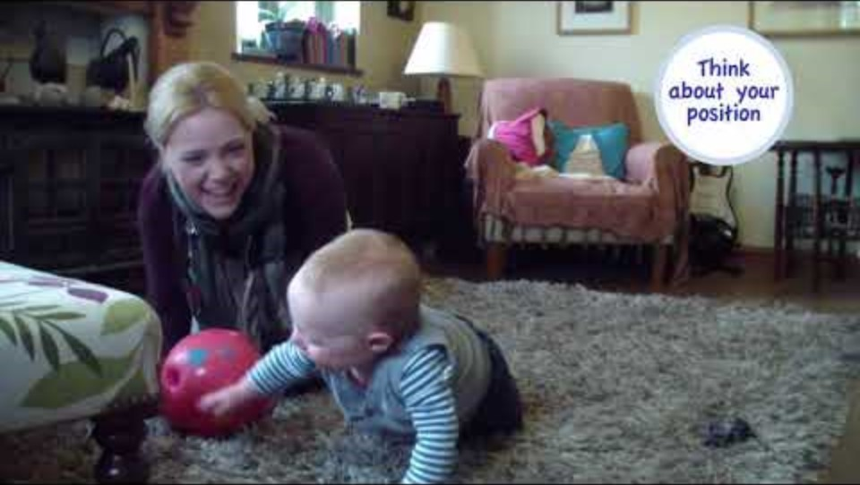
May I Join You?
Notes:
25
25
Dr Helen Delargy, Consultant Clinical Psychologist Helen.Delargy@wales.nhs.uk) had already realised this was a key need back in 2016 and developed a resource called “May I join You?” This is a bilingual resource in English and Welsh which aims to develop an understanding of the underlying principles of PACT and is especially aimed at skilling up the people who support autistic children in their nurseries and schools.
There is a handbook, a video and an effective training workshop.

Slide 26
Key elements of May I Join You? Training
Sharing information about better understanding social communication differences.
Watching the video to understand key strategies which are likely to enable staff to “tune in” more sensitively to the children in their setting.
Role play to try out these strategies and reflect together.
Video reflection : Noticing what strategies are supportive in their own play with children in their setting.
Notes:
This slide speaks for itself.

Slide 27
A typical journey
SPECIALIST support : PACT with parents and MIJY training to the setting.
Step down then to TARGETTED support (4 visits per year) to offer further advice/support as needed.
Once everything is in place and everyone around a child is skilled to support them DISCHARGE this episode of care to UNIVERSAL support.
A re-referral can be made if further support is needed in the future.
Notes:
Children do not need a diagnosis of Autism or an EHCP to access our social communication pathway.

Slide 28
Working collaboratively
Sharing PACT principles alongside the MIJY with our colleagues in the EYSEN Education team Nov 2022 to ensure a consistent approach around the child wherever they were and whoever was supporting.
From this agreed as a whole team SLT and Education to grow the reach of these principles across the county.
Communication and Interaction Team training : Nov 2023/Feb 2024
Community Paediatricians
We are incredibly grateful for the collaboration and joint working to support all of our settings, children and families.
Notes:
In Oxfordshire we are incredibly fortunate to work closely alongside our colleagues in Education; both Early Year SEN Advisory teacher and the Communication and Interaction team. In November 2022 we had a whole team day where we looked in more detail at how we were supporting our young autistic children, their families and settings and took time to share our knowledge of PACT and to introduce “May I join You?” as a resource.
This has led to lots of joint working, jointly delivering training in settings and ensuring a consistent approach with families.
We are now also working in the same way with our colleagues in the Communication and Interaction Team.

Slide 29
Where we are now
Lead early Years Advisory Teacher has championed “May I join You?” for use with all children in all settings at a universal level.
All Health visitors aware of PACT in Oxfordshire.
Community Paediatricians aware and supportive of our PACT work and talking about this with families.
Notes:
Working on the principle that every child benefits from someone taking time to tune in more to them during play, to share their interests. We see this as a way of getting to know all children better and all children developing their confidence to interact and communicate.

Slide 30
Current pilot projects
MIJY training for parents of children in one special school and one mainstream primary as a pilot for settings where staff have already had the training.
Catching the children where PACT wasn’t available within the service when they were pre-schoolers.
But being mindful that we hope to grow capacity to offer PACT to more of these older children when needed.

Slide 31
Vision
Special schools : PACT principles to be universal the minute children walk through the door.
May I Join You? In every single setting Early Years setting and Primary school within 2 years.
Embedding PACT strategies into EHCPs in collaboration with Educational Psychologists.
Liaison and sharing our work with CAMHS.
Evidence the impact of 6 PACT sessions.
Notes:
Share your vision here Katy with passion!

Slide 32
Thank you so much for listening

